Slide 1


ACCS16301
COALP
Unit – 9 Pipeline & Vector Processing
Er. Pavitar Singh
(Assistant Professor)
pavitar.cse@acetedu.in

Slide 2
Topics to be covered
Parallel Processing
Pipelining
Arithmetic Pipeline
Instruction Pipeline
Unit – 9: Pipeline & Vector Processing Amritsar Group Of Colleges

Slide 3
Parallel Processing
Unit – 9: Pipeline & Vector Processing Amritsar Group Of Colleges

Slide 4
Parallel Processing
Parallel processing is a term used to denote a large class of techniques that are used to provide simultaneous data-processing tasks for the purpose of increasing the computational speed of a computer system.
Purpose of parallel processing is to speed up the computer processing capability and increase its throughput.
Throughput:
The amount of processing that can be accomplished during a given interval of time.
Unit – 9: Pipeline & Vector Processing Amritsar Group Of Colleges

Slide 5
Multiple Functional Unit : Separate the execution unit into eight functional units operating in parallel
Unit – 9: Pipeline & Vector Processing Amritsar Group Of Colleges

Slide 6
Parallel Processing Computers
Areas ::
Applications
Scientific
Engineering
Military
Medical
Artificial Intelligence
Basic Research
Numerical Weather Forecasting
Computational Aerodynamics
Finite element analysis
Remote Sensing
Genetic Engineering
Computer Assisted Tomography
Weapon & Defense.
Unit – 9: Pipeline & Vector Processing Amritsar Group Of Colleges

Slide 7
Pipelining
Unit – 9: Pipeline & Vector Processing Amritsar Group Of Colleges
Unit – 6: Pipeline & Vector Processing Darshan Institute of Engineering & Technology

Slide 8
Pipelining
Pipeline is a technique of decomposing a sequential process into sub operations, with each sub process being executed in a special dedicated segment that operates concurrently with all other segments.
A pipeline can be visualized as a collection of processing segments through which binary information flows.
Each segment performs partial processing dictated by the way the task is partitioned.
The result obtained from the computation in each segment is transferred to the next segment in the pipeline.
The registers provide isolation between each segment.
The technique is efficient for those applications that need to repeat the same task many times with different sets of data.
Unit – 9: Pipeline & Vector Processing Amritsar Group Of Colleges

Slide 9
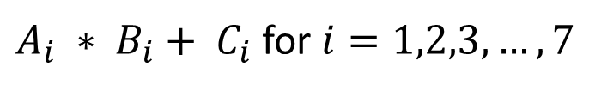
Pipelining example
$A_{i} ∗ B_{i}+ C_{i}$ for $i=1,2,3,…,7$
R1
R2
Multiplier
R3
R4
Adder
R5
Unit – 9: Pipeline & Vector Processing Amritsar Group Of Colleges

Slide 10
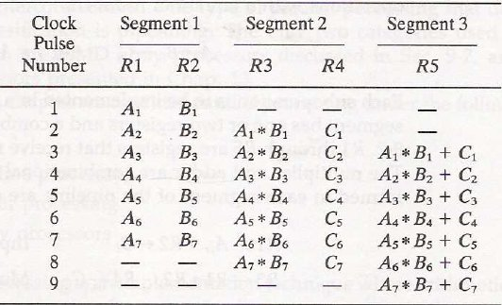
Sub operation Segment
1) : Input Ai and Bi
2) : Multiply and input Ci
3) : Add Ci
Content of registers in pipeline example
Unit – 9: Pipeline & Vector Processing Amritsar Group Of Colleges

Slide 11
Pipelining
General structure of four segment pipeline
Clock
S₁
R₁
S₂
R₂
S₃
R₃
S₄
R₄
Input
Unit – 9: Pipeline & Vector Processing Amritsar Group Of Colleges

Slide 12
Now consider the case where k-segment pipeline with a clock cycle time tp is used to execute n tasks.
The first task T1 requires a time=k*tp
The remaining n-1 tasks emerge from the
pipe at the rate of one task per clock cycle
& time to complete (n-1)*tp
For a pipelined system: k+(n-1) clock cycles
Pipeline: 4+(6-1)= 9 clock cycles

Slide 13
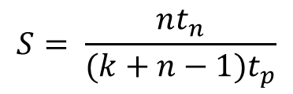
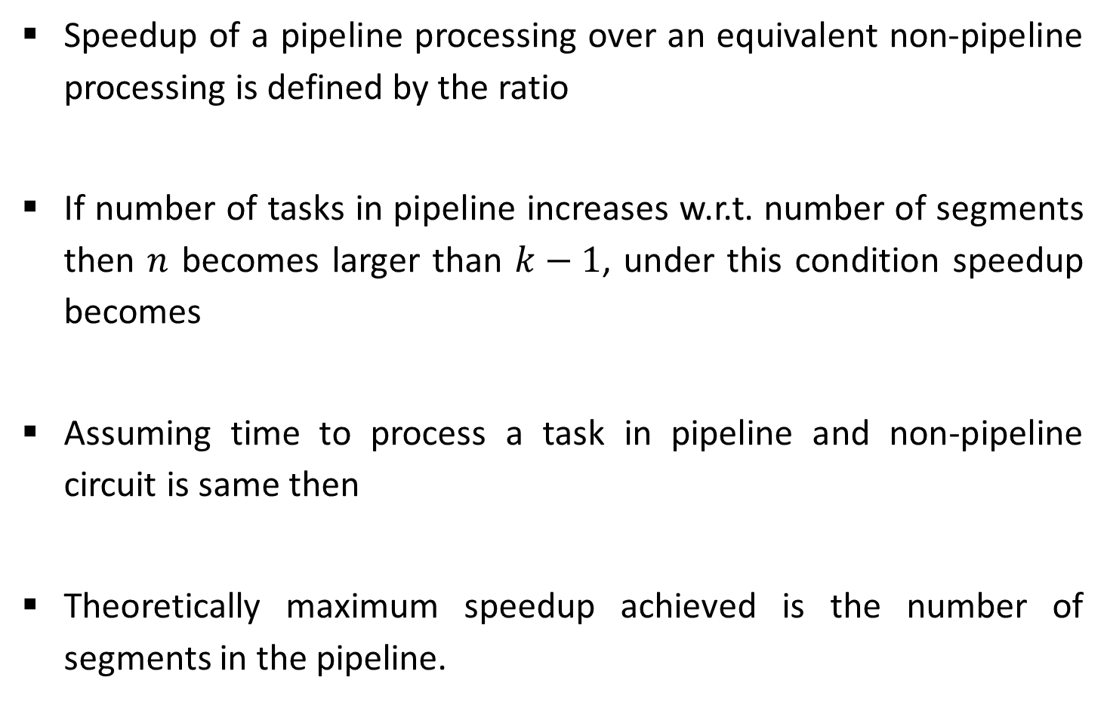


Speedup
Speedup of a pipeline processing over an equivalent non-pipeline processing is defined by the ratio
If number of tasks in pipeline increases w.r.t. number of segments then $n$ becomes larger than $k−1$, under this condition speedup becomes
Assuming time to process a task in pipeline and non-pipeline circuit is same then
Theoretically maximum speedup achieved is the number of segments in the pipeline.
$$S= \frac{nt_{n}}{(k+n−1)t_{p}}$$
$$S=\frac{{nt}_{n}}{{nt}_{p}}=\frac{t_{n}}{t_{p}}$$
$$S= \frac{{kt}_{p}}{t_{p}}=k$$
Unit – 9: Pipeline & Vector Processing Amritsar Group Of Colleges

Slide 14
Arithmetic Pipeline
Unit – 9: Pipeline & Vector Processing Amritsar Group Of Colleges
Unit – 6: Pipeline & Vector Processing Darshan Institute of Engineering & Technology

Slide 15
Arithmetic Pipeline
Usually found in high speed computers.
Used to implement floating point operations, multiplication of fixed point numbers and similar operations.
Unit – 9: Pipeline & Vector Processing Amritsar Group Of Colleges

Slide 16

Example of Arithmetic Pipeline
Consider an example of floating point addition and subtraction.
$$X=A ×{10}^{a}$$
$$Y=B ×{10}^{b}$$
A and B are two fractions that represent the mantissas and a and b are the exponents.
Unit – 9: Pipeline & Vector Processing Amritsar Group Of Colleges
Unit – 9: Pipeline & Vector Processing Amritsar Group Of Colleges

Slide 17
Example of Arithmetic Pipeline
Consider the two normalized floating-point numbers:
X = 0.9504 x 10³ Y = 0.8200 x 10²
Segment-1: Compare the exponents.
Segment-2: Aligning the mantissa numbers
X = 0.9504 x 10³ Y = 0.0820 x 10³
Segment-3: Addition of the two mantissas produces the sum
Z = 1.0324 x 10³
Segment-4: Normalize the result
Z = 0.10324 x 10⁴
Unit – 9: Pipeline & Vector Processing Amritsar Group Of Colleges

Slide 18
Example of Arithmetic Pipeline
The sub-operations that are performed in the four segments are:
Compare the exponents
Align the mantissas
Add or subtract the mantissas
Normalize the result
Unit – 9: Pipeline & Vector Processing Amritsar Group Of Colleges

Slide 19
A
Mantissas
a
Exponents
B
b
R
R
Segment 1:
Compare exponents by subtraction
Difference
R
Segment 2:
Choose exponent
Align mantissas
R
Segment 3:
Add or subtract mantissas
R
R
Segment 4:
Adjust exponent
Normalize result
R
R

Slide 20
Instruction Pipeline
Unit – 6: Pipeline & Vector Processing Darshan Institute of Engineering & Technology
Unit – 9: Pipeline & Vector Processing Amritsar Group Of Colleges

Slide 21
Instruction Pipeline
In the most general case, the computer needs to process each instruction with the following sequence of steps
Fetch the instruction from memory.
Decode the instruction.
Calculate the effective address.
Fetch the operands from memory.
Execute the instruction.
Store the result in the proper place.
Different segments may take different times to operate on the incoming information.
Some segments are skipped for certain operations.
The design of an instruction pipeline will be most efficient if the instruction cycle is divided into segments of equal duration.
Unit – 9: Pipeline & Vector Processing Amritsar Group Of Colleges

Slide 22
Instruction Pipeline
Assume that the decoding of the instruction can be combined with the calculation of the effective address into one segment.
Assume further that most of the instructions place the result into a processor registers so that the instruction execution and storing of the result can be combined into one segment.
This reduces the instruction pipeline into four segments.
FI: Fetch an instruction from memory
DA: Decode the instruction and calculate the effective address of the operand
FO: Fetch the operand
EX: Execute the operation
Unit – 9: Pipeline & Vector Processing Amritsar Group Of Colleges

Slide 23
Four segment CPU pipeline
Fetch instruction from memory
Segment1:
Segment2:
Decode instruction & calculate effective address
yes
Branch?
no
Segment3:
Fetch operand from memory
Segment4:
Execute instruction
Interrupt handling
yes
Interrupt?
no
Update PC
Empty pipe
Unit – 9: Pipeline & Vector Processing Amritsar Group Of Colleges

Slide 24
Space-time Diagram
Step:
1 | 2 | 3 | 4 | 5 | 6 | 7 | 8 | 9 | 10 | 11 | 12 | 13
FI | DA | FO | EX
 | FI | DA | FO | EX
 |  | FI | DA | FO | EX
 |  |  | FI | DA | FO | EX
 |  |  |  | FI | DA | FO | EX
 |  |  |  |  | FI | DA | FO | EX
 |  |  |  |  |  | FI | DA | FO | EX
Instruction 1
2
3
4
5
6
7
Unit – 9: Pipeline & Vector Processing Amritsar Group Of Colleges

Slide 25
Space-time Diagram
Step:
1 | 2 | 3 | 4 | 5 | 6 | 7 | 8 | 9 | 10 | 11 | 12 | 13
FI | DA | FO | EX
 | FI | DA | FO | EX
 |  | FI | DA | FO | EX
 |  |  | FI | - | - | FI | DA | FO | EX
 |  |  |  | - | - | - | FI | DA | FO | EX
 |  |  |  |  |  |  |  | FI | DA | FO | EX
 |  |  |  |  |  |  |  |  | FI | DA | FO | EX
Instruction 1
2
(Branch)
3
4
5
6
7
Unit – 9: Pipeline & Vector Processing Amritsar Group Of Colleges

Slide 26
Pipeline Conflict
There are three major difficulties that cause the instruction pipeline conflicts.
Resource conflicts caused by access to memory by two segments at the same time. Most of these conflicts can be resolved by using separate instruction and data memories.
Data dependency conflicts arise when an instruction depends on the result of a previous instruction, but this result is not yet available.
Branch difficulties arise from branch and other instructions that change the value of PC.(interrupt or return)
Unit – 9: Pipeline & Vector Processing Amritsar Group Of Colleges

Slide 27
Data Dependency
Data dependency occurs when an instruction needs data that are not yet available.
Pipelined computers deal with such conflicts between data dependencies in a variety of ways as follows:
Hardware Interlocks
Operand forwarding
Delayed load
Unit – 9: Pipeline & Vector Processing Amritsar Group Of Colleges

